Slide 1

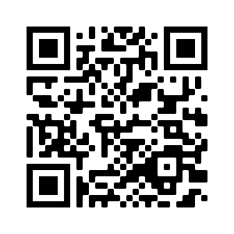

Welcome to…
David E. Bernholdt, Anshu Dubey, Mark C. Miller, Katherine M. Riley, and James M. Willenbring
Software Productivity Track, ATPESC 2020
Tutorial slides: https://app.box.com/folder/118663987937 or https://doi.org/10.6084/m9.figshare.12719834
See slide 2 for license details and requested citation

Slide 2
License, Citation and Acknowledgements
License and Citation
This work is licensed under a Creative Commons Attribution 4.0 International License (CC BY 4.0).
The requested citation the overall tutorial is: David E. Bernholdt, Anshu Dubey, Mark C. Miller, Katherine M. Riley, and James M. Willenbring, Software Productivity Track, in Argonne Training Program for Extreme Scale Computing (ATPESC), August 2020, online. DOI: 10.6084/m9.figshare.12719834
Individual modules may be cited as Speaker, Module Title, in Software Productivity Track…
Acknowledgements
Additional contributors include: Patricia Grubel, Rinku Gupta, Mike Heroux, Alicia Klinvex, Jared O’Neal, David Rogers, Deborah Stevens
This work was supported by the U.S. Department of Energy Office of Science, Office of Advanced Scientific Computing Research (ASCR), and by the Exascale Computing Project (17-SC-20-SC), a collaborative effort of the U.S. Department of Energy Office of Science and the National Nuclear Security Administration.
This work was performed in part at the Argonne National Laboratory, which is managed by UChicago Argonne, LLC for the U.S. Department of Energy under Contract No. DE-AC02-06CH11357.
This work was performed in part at the Oak Ridge National Laboratory, which is managed by UT-Battelle, LLC for the U.S. Department of Energy under Contract No. DE-AC05-00OR22725.
This work was performed in part at the Lawrence Livermore National Laboratory, which is managed by Lawrence Livermore National Security, LLC for the U.S. Department of Energy under Contract No. DE-AC52-07NA27344.
This work was performed in part at Sandia National Laboratories. Sandia National Laboratories is a multi-mission laboratory managed and operated by National Technology and Engineering Solutions of Sandia, LLC., a wholly owned subsidiary of Honeywell International, Inc., for the U.S. Department of Energy’s National Nuclear Security Administration under contract DE-NA0003525.

Slide 3
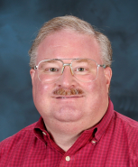
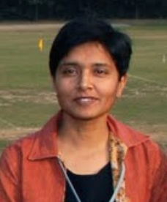
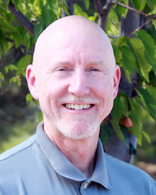
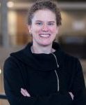
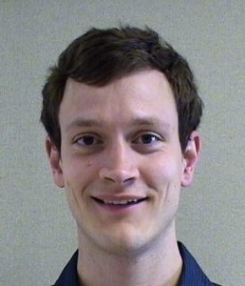
Tutorial Instructors
David Bernholdt, ORNL
Anshu Dubey, ANL
Mark Miller, LLNL
Katherine Riley, ANL
James Willenbring, SNL
With help from: Pat Grubel, LANL; Rinku Gupta, ANL; David Rogers, ORNL
Member of the IDEAS Productivity Project: http://ideas-productivity.org
Focus: Increasing CSE software productivity, quality, and sustainability
David
Anshu
Mark
Katherine
Jim

Slide 4
The IDEAS-ECP team works with the ECP community to improve developer productivity and software sustainability as key aspects of increasing overall scientific productivity
Establish software communities
Determine community policies to improve software quality and compatibility
Create Software Development Kits (SDKs) to facilitate the combined use of complementary libraries and tools
1
Customize and curate methodologies
Target scientific software productivity and sustainability
Use workflow for best practices content development
3
Incrementally and iteratively improve software practices
Determine high-priority topics for improvement and track progress
Productivity and Sustainability Improvement Planning (PSIP)
Engage in community outreach
Broad community partnerships
Collaboration with computing facilities
Webinars, tutorials, events
WhatIs and HowTo docs
Better Scientific Software site (https://bssw.io)
2
4

Slide 5

Building an Online Community
https://bssw.io
New community-based resource for scientific software improvement
A central hub for sharing information on practices, techniques, experiences, and tools to improve developer productivity and software sustainability for computational science & engineering (CSE)
Goals
Raise awareness of the importance of good software practices to scientific productivity and to the quality and reliability of computationally-based scientific results
Raise awareness of the increasing challenges facing CSE software developers as high-end computing heads to extreme scales
Help CSE researchers increase effectiveness as well as leverage and impact
Facilitate CSE collaboration via software in order to advance scientific discoveries
Site users can…
Find information on scientific software topics
Contribute new resources based on your experiences
Create content tailored to the unique needs and perspectives of a focused scientific domain

Slide 6
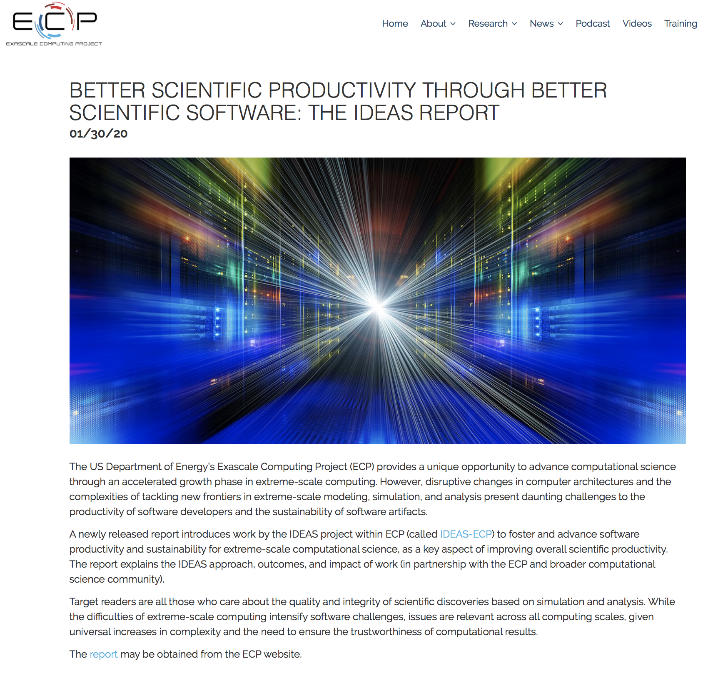
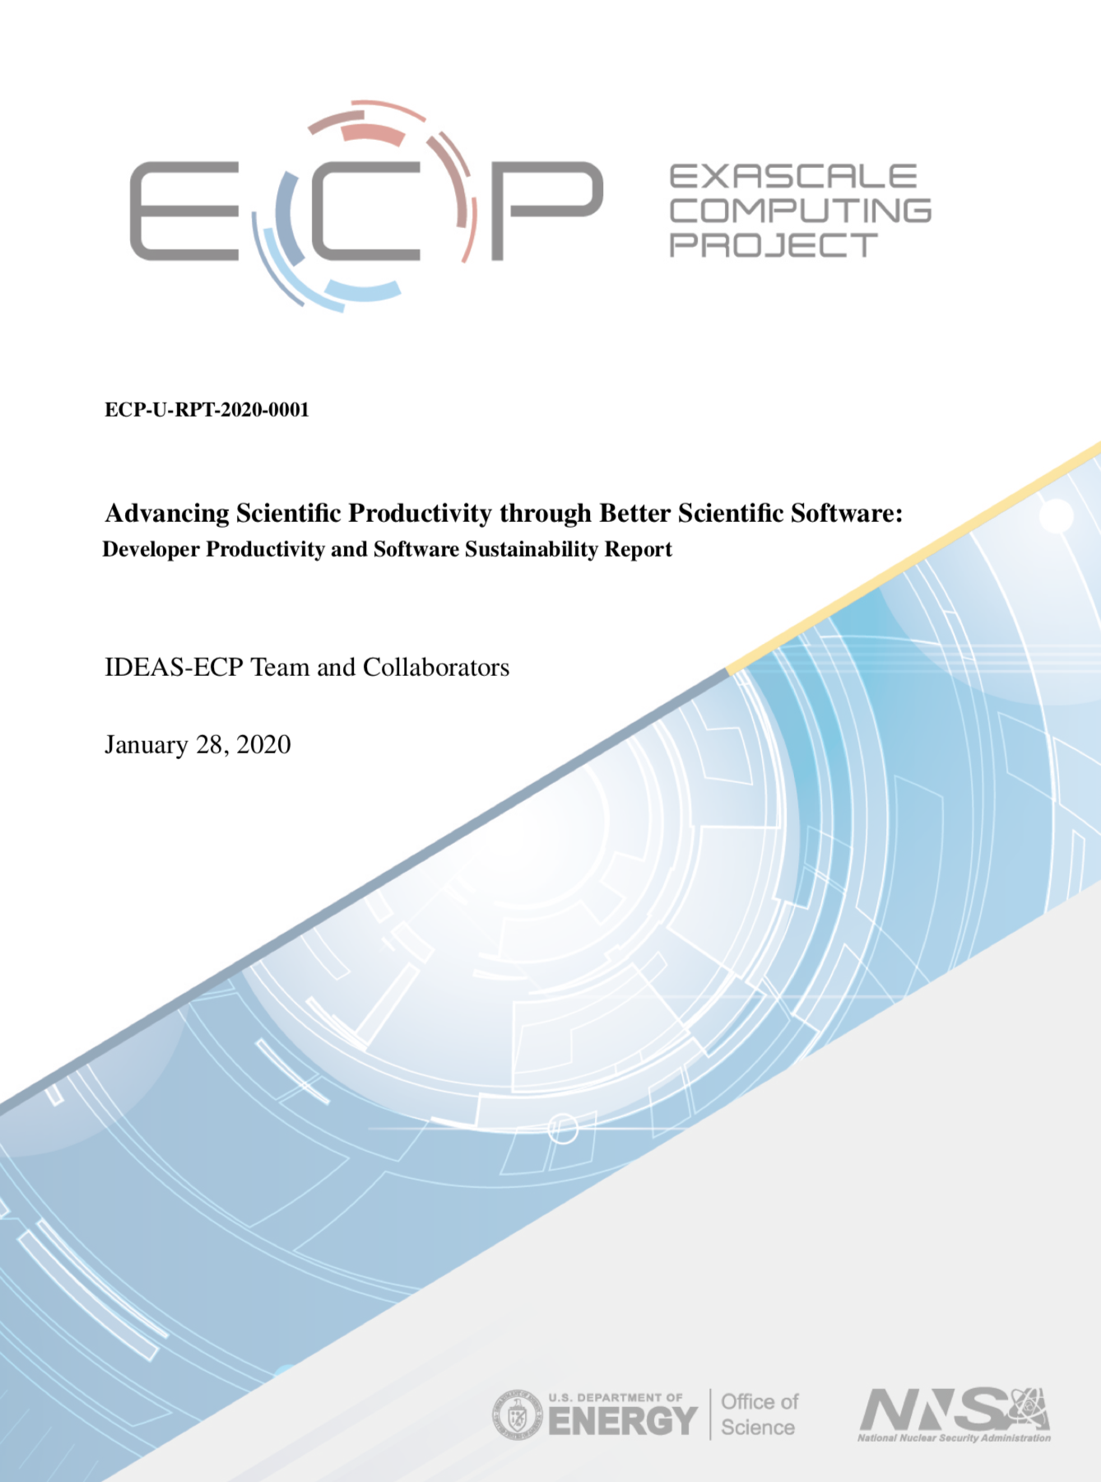
Advancing Scientific Productivity through Better Scientific Software: Developer Productivity and Software Sustainability Report
Disruptive changes in computer architectures and the complexities of tackling new frontiers in extreme-scale modeling, simulation, and analysis present daunting challenges to software productivity and sustainability.
This newly released report explains the IDEAS approach, outcomes, and impact of work (in partnership with the ECP and broader computational science community).
Target readers are all those who care about the quality and integrity of scientific discoveries based on simulation and analysis. While the difficulties of extreme-scale computing intensify software challenges, issues are relevant across all computing scales, given universal increases in complexity and the need to ensure the trustworthiness of computational results.
January 2020
https://exascaleproject.org/better-scientific-productivity-through-better-scientific-software-the-ideas-report

Slide 7


Follow IDEAS and BSSw
IDEAS Productivity mailing list: http://eepurl.com/cQCyJ5
Announcements of IDEAS-organized events
Best Practices for HPC Software Developers webinar series
Strategies for Working Remotely panel series
Major scientific meetings (e.g., SIAM, ISC, SC, etc.)
Typically 1-2 messages per month
BSSw Digest: https://bssw.io/pages/receive-our-email-digest
Updates on BSSw content
New blog posts, events, and resources
BSSw Fellowship
Typically 1-2 messages per month
Also: RSS feed: https://bssw.io/items.rss

Slide 8
Tutorial Objectives
Overview of best practices in software engineering explicitly tailored for CSE
Why: Increase CSE software quality, sustainability, productivity
Better CSE software > better CSE research > broader CSE impact
Who: Practices relevant for projects of all sizes
emphasis on small teams, e.g., a faculty member and collaborating students
Approach:
Useful information, examples, exercises, pointers to other resources
Not to prescribe any particular practices as “must use”
Be informative about practices that have worked for some projects
Emphasis on adoption of practices that help productivity rather than put unsustainable burden
Customize as needed for each project
Remember: your code will live longer than you expect. Prepare for it!
Old Process
New Process
Cost
Start
Progress
Finish

Slide 9
Hands-On Activities
We have a repository, based on the Heat Equation example used on Tuesday that we will use to demonstrate some concepts, and there will be some exercises you can do as “homework”, if desired.
You will need…
GitHub account
Fork of the tutorial GitHub repository
https://github.com/betterscientificsoftware/hello-numerical-world-atpesc-2020
You can submit your work for feedback by making pull requests to the upstream repo
We will provide feedback as quickly as we can, but please be patient
Access to a working development environment for C++ and/or Fortran
Typical Linux or Mac systems should be fine (git, editor, compilers, make, etc.)
Using a remote system is fine

Slide 10
Handling Questions and Discussion
We’ll try to stop for questions from time to time
Members of the IDEAS team will be monitoring the chat
If the presenter asks for questions, you can unmute and ask
Otherwise, please use chat
We can also be available during breaks, lunch, and after the session for additional conversations
Please use the chat to let us know who you’d like to talk to just before the break
And remember that we may need a break too
Also, feel free to email us at bssw-tutorial@lists.mcs.anl.gov
The list moderator will allow your messages to be posted

Slide 11
Agenda
Time (Central TZ) | Module | Topic | Speaker
9:30am-9:45am | 00 | Introduction | David E. Bernholdt, ORNL
9:45am-10:15am | 01 | Overview of Best Practices in HPC Software Development | Katherine M. Riley, ANL
10:15am-10:45am | 02 | Agile Methodologies | James M. Willenbring, SNL
10:45am-11:00am | 03 | Git Workflows | James M. Willenbring, SNL
11:00am-11:15am |  | Break (and Q&A with speakers)
11:15am-12:00pm | 04 | Software Design | Anshu Dubey, ANL
12:00pm-12:45pm | 05 | Software Testing | Anshu Dubey, ANL
12:45pm-1:45pm |  | Lunch (and Q&A with speakers)
1:45pm-2:00pm | 06 | Agile Methodologies Redux | James M. Willenbing, SNL
2:00pm-3:00pm | 07 | Refactoring | Anshu Dubey, ANL
3:00pm-3:15pm |  | Break (and Q&A with speakers)
3:15pm-3:45pm | 08 | Continuous Integration | Mark C. Miller, LLNL
3:45pm-4:30pm | 09 | Reproducibility | David E. Bernholdt, ORNL
4:30pm-4:45pm | 10 | Summary | David E. Bernholdt, ORNL

